Slide 1

Final Project (TIC)
FULL NAME : RAHMANI AHMED
SECTION : [A] INFO ING PROFESSOR : redouane bouchkir
GROUPE : 1
2023 / 2024

Slide 2
plan
Introduction to (TIC) .
Importance of TIC .
Google services .
Microsoft Tools .
Git and GitHub .
Conclusion .

Slide 3
Introduction to (TIC)
TIC stands for Technology, Information, and Communication, representing key elements in today's interconnected world , TIC alludes to cluster of advances that encourage the procurement, handling, capacity, and spread of data.
Importance of (TIC)
Enhanced Communication:
TIC an essential part in changing the way we communicate from emails to video conferencing, these advances empower real-time intuitive, cultivating collaboration.

Slide 4
Information Administration:
TIC supports the successful organization, of data,and information analytics devices enable businesses and people to tackle the control of data for key decision-making.
Global Network:
Companies are allowed to operate on a global scale and people can cooperate across borders in addition to sharing data globally.
Innovation and Robotization:
TIC serves as a development by giving devices and that streamline forms.

Slide 5
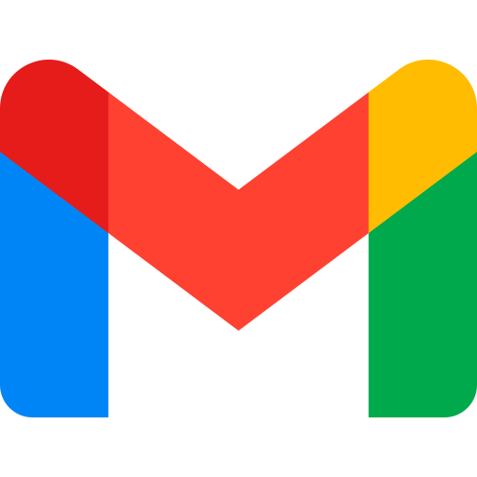



Google Services
Gmail
Google Drive
Google Drive is a cloud-based file storage and synchronization service provided by Google, allowing users to store and access files from various devices over the internet.
Gmail is a free email service developed by Google, allowing users to send and receive emails over the internet.
GoogleWorkspace
Google Cloud Platform
Google Cloud Platform (GCP) is a suite of cloud computing services provided by Google, offering infrastructure as a service (IaaS), platform as a service (PaaS), and other cloud-based solutions for businesses and developers.
Google Workspace is a suite of cloud computing Google, including Gmail, Google Drive, Google Docs,designed for business and professional use

Slide 6




Microsoft Tools
Microsoft 365
Visual Studio
Microsoft 365 is a subscription-based suite of productivity tools and cloud services provided by Microsoft, including applications like Word, Excel, PowerPoint, and cloud services like OneDrive and Microsoft Teams
Visual Studio is an integrated development environment (IDE) created by Microsoft for building, debugging, and deploying software applications across various platforms
Azure
Power BI
Microsoft's cloud computing platform offering a range of services for building, deploying, and managing applications
Power BI is a business analytics tool by Microsoft that enables users to visualize and analyze data through interactive dashboards and reports

Slide 7


Git and GitHub
Git
GitHub
Git is a distributed version control system used for tracking changes in source code during software development.
GitHub is a web-based platform that utilizes Git for version control, providing a collaborative environment for developers to host, share, and manage code repositories
Git vs GitHub: What's the Difference?
Git is a version control system that allows developers to track changes in their code. GitHub is a web-based hosting service for git repositories. In simple terms, you can use git without Github, but you cannot use GitHub without Git. Take note of the following illustration for further information on the distinctions between the two

Slide 8
Conclusion
Finaly, Information and Communication Technologies, along with technologies like Google services, Microsoft tools, Git, and GitHub, are shaping the way we communicate.
The continuous evolution of these technologies empowers individuals and organizations to thrive in the digital era.
informed about the latest advancements in TIC and leveraging these tools will be crucial for success in an increasingly connected and technologically-driven world.

